Slide 1

HW3:One 0K Rock
(zero)
Notes:
BGM:https://www.youtube.com/watch?v=cnM07bF_43w

Slide 2

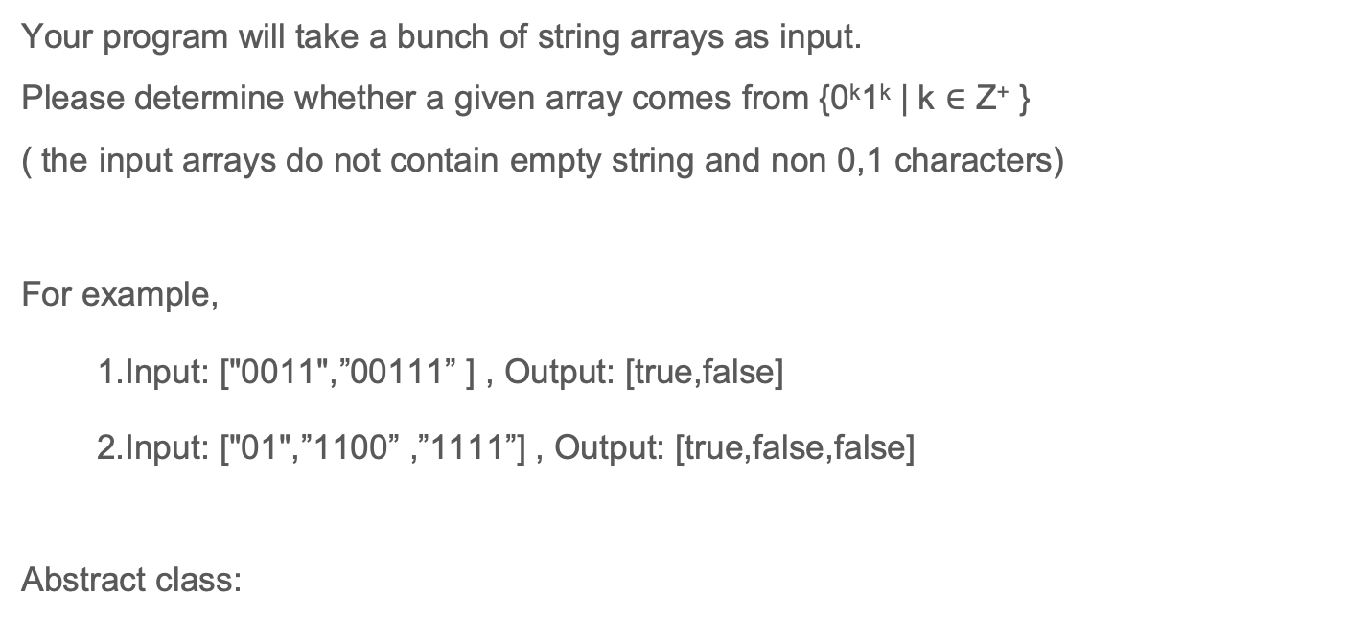
Assignment Requirement:
Your program will take a bunch of string arrays as input.
Please determine whether a given array comes from {0^{k}1^{k} | k $∈$ Z⁺ }
( the input arrays do not contain empty string and non 0,1 characters)
For example,
1.Input: ["0011",”00111” ] , Output: [true,false]
2.Input: ["01",”1100” ,”1111”] , Output: [true,false,false]
Abstract class:
Notes:
https://www.youtube.com/watch?v=cnM07bF_43w

